Slide 1
Type Casting
https://www.geeksforgeeks.org/static_cast-in-cpp/?ref=lbp
Casting is a technique by which one data type can be converted to another data type.
C++ supports 4 types of casting:
Static Cast
Dynamic Cast
Const Cast
Reinterpret Cast

Slide 2
Type Casting in C++
A type cast is basically a conversion from one type to another.
Types of conversions:
Implicit Type Conversion.
Explicit Type Conversion.
Converting by assignment.
Conversion using Cast operator.

Slide 3
Implicit Type Conversion
bool -> char -> short int -> int ->
bool -> char -> short int -> int ->
long long -> float -> double -> long double

Slide 4
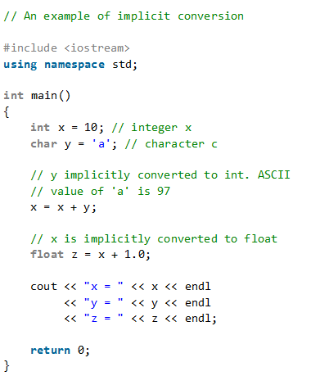

Slide 5
Explicit Type Conversion
double x = 1.2;
// Explicit conversion from double to int
int sum = (int)x + 1;
It is possible for conversions to lose information, signs can be lost (when signed is converted to unsigned), and overflow can occur (when long long is converted to float).
Converting by assignment.
(type) expression

Slide 6
Static Cast
This is the simplest type of cast that can be used.
It is a compile-time cast.
It does things like implicit conversions between types (such as int to float, or pointer to void*), and it can also call explicit conversion functions.
static_cast <dest_type> (source);

Slide 7
Upcasting & Downcasting
static_cast can provide both upcasting and downcasting in case of inheritance.
So to use static_cast in case of inheritance, the base class must be accessible, non-virtual, and unambiguous.

Slide 8
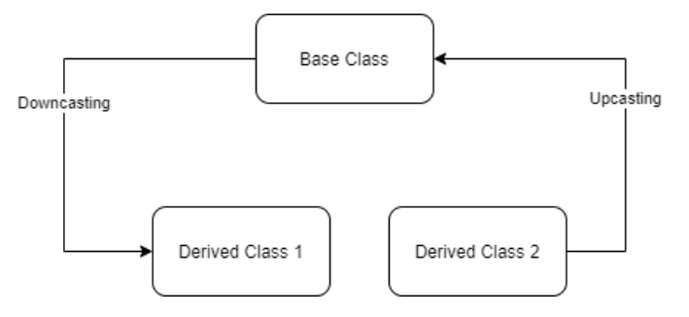

Slide 9
Dynamic Cast
In C++, dynamic casting is mainly used for safe downcasting at run time.
To work on dynamic_cast there must be one virtual function in the base class.
A dynamic_cast works only polymorphic base class because it uses this information to decide safe downcasting.

